Slide 1


CAPSTONE PROJECT
CAPSTONE PROJECT: APPLYING CRYPTOGRAPHY IN REAL-WORLD SCENARIOS
Disclaimer: This training material belongs to techcrush and shouldn’t be shared

Slide 2
CAPSTONE PROJECT
Group No.8
Team Members;
1- ALIMI ADAM CS/2025/TC3/072 2- Michael Sonibe CS/2025/TC3/445
3- Mofiyinfoluwa Adesanya CS/2025/TC3/449 4- Al-mustapha Sule CS/2025/TC3/073
5- Agbaje Amir CS/2025/TC3/079 6- Amarachi CS/2025/TC3/078
7- Akinbode Mojisola CS/2025/TC3/452 8- Josu Micheal CS/2025/TC3/446
9- Amaka kanu. CS/2025/TC3/076 10- Anas Haruna: CS/2025/TC3/081
11- Mofehintoluwa Maraiyesa: CS/2025/TC3/448 12- AMUSAT Zainab CS/2025/TC3/080
Disclaimer: This training material belongs to techcrush and shouldn’t be shared

Slide 3
CAPSTONE PROJECT
Outline
Aim and Objective
Methodology
  Concept of project
  Tools Used
Conclusion
References
Disclaimer: This training material belongs to techcrush and shouldn’t be shared

Slide 4
CAPSTONE PROJECT
Aim and Objective
This project aims to:
Understand fundamental cryptographic concepts
Implement encryption and decryption using command-line tools
Demonstrate data integrity verification through hashing
Apply public key cryptography for secure messaging
Simulate real-world security scenarios
Disclaimer: This training material belongs to techcrush and shouldn’t be shared

Slide 5
CAPSTONE PROJECT
Methodology
OpenSSL - Cryptographic toolkit for encryption, hashing, and key generation
Windows: Download from openssl.org
GPG (GNU Privacy Guard) - Implementation of PGP for encryption and signing
Windows: Download GPG4Win from gpg4win.org
Disclaimer: This training material belongs to techcrush and shouldn’t be shared

Slide 6
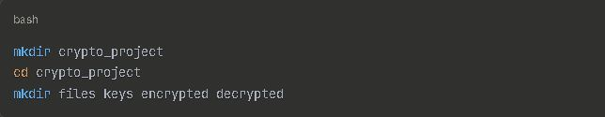
CAPSTONE PROJECT
Creating a Project Directory via Ubuntu
Disclaimer: This training material belongs to techcrush and shouldn’t be shared

Slide 7
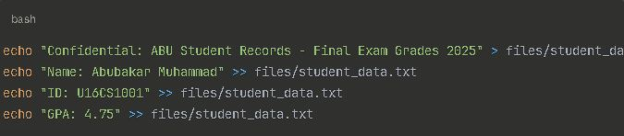
CAPSTONE PROJECT
Creating a Sample File of Student Data
Disclaimer: This training material belongs to techcrush and shouldn’t be shared

Slide 8



CAPSTONE PROJECT
Encryption & Decryption Using AES(Output Match Original)
Disclaimer: This training material belongs to techcrush and shouldn’t be shared

Slide 9


CAPSTONE PROJECT
Hashing from Student data File with the Output
Disclaimer: This training material belongs to techcrush and shouldn’t be shared

Slide 10

CAPSTONE PROJECT
Detect tempering in Hashing
sha256sum -c files/student_data.hash
By trying to verify with old Hash
The Output shows Failed
Disclaimer: This training material belongs to techcrush and shouldn’t be shared

Slide 11



CAPSTONE PROJECT
Hashing Modification showing Entirely Different result
Disclaimer: This training material belongs to techcrush and shouldn’t be shared

Slide 12
CAPSTONE PROJECT
Decrypting to Retrieve the Original Data (Output Matches)
Disclaimer: This training material belongs to techcrush and shouldn’t be shared

Slide 13


CAPSTONE PROJECT
Digital Signature (Signs Document & Verified Doc)
Disclaimer: This training material belongs to techcrush and shouldn’t be shared

Slide 14

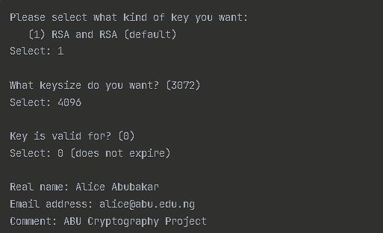
CAPSTONE PROJECT
Generating Key Pair with GPG with Interactive Prompts
Disclaimer: This training material belongs to techcrush and shouldn’t be shared

Slide 15

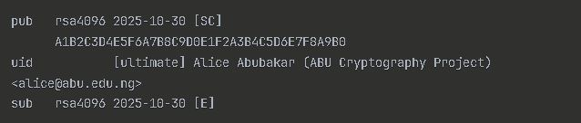
CAPSTONE PROJECT
List of Keys Generated and Public Key Output
Disclaimer: This training material belongs to techcrush and shouldn’t be shared

Slide 16
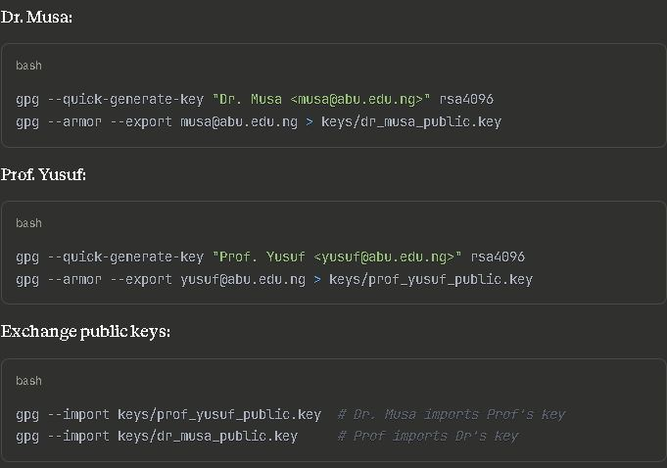
CAPSTONE PROJECT
Generating Keys for both Parties demonstrating Secure Messaging
Disclaimer: This training material belongs to techcrush and shouldn’t be shared

Slide 17
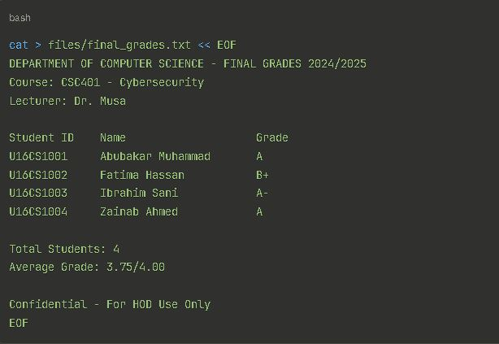
CAPSTONE PROJECT
Real World-Senario Example(Confidential Doc)
Disclaimer: This training material belongs to techcrush and shouldn’t be shared

Slide 18
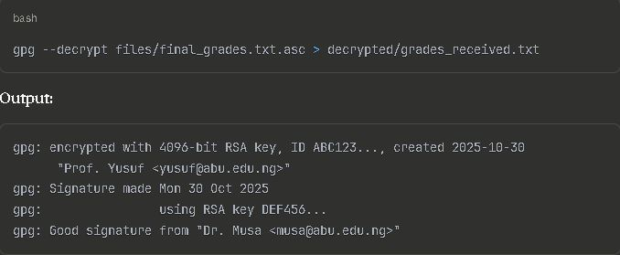
CAPSTONE PROJECT
Real World-Senario Example(Retrieved and Decrypt Doc)
Disclaimer: This training material belongs to techcrush and shouldn’t be shared

Slide 19
CAPSTONE PROJECT
Conclusion
This project successfully demonstrated practical applications of cryptography using command-line tools. We implemented:
Symmetric Encryption (AES-256) - Fast encryption for confidentiality
Hashing (SHA-256) - Integrity verification and tamper detection
Asymmetric Encryption (RSA-4096) - Secure key exchange and messaging
Digital Signatures - Authentication and non-repudiation
Real-World Scenario - Secure email exchange with multiple security properties
Key Takeaways
Confidentiality: Encryption ensures only authorized parties can read data
Integrity: Hashing detects any unauthorized modifications
Authentication: Digital signatures prove sender identity
Practical Skills: Command-line tools provide full control over cryptographic operations
Cryptography is the backbone of modern digital security. Understanding its practical implementation empowers us to build and use secure systems effectively.
Disclaimer: This training material belongs to techcrush and shouldn’t be shared

Slide 20
CAPSTONE PROJECT
References
OpenSSL Documentation
https://www.openssl.org/docs/
GnuPG User Guide
https://www.gnupg.org/documentation/
NIST Cryptographic Standards
https://csrc.nist.gov/publications
Applied Cryptography by Bruce Schneier
Wiley, 2nd Edition
Cryptography and Network Security by William Stallings
Pearson, 7th Edition
The GNU Privacy Handbook
https://www.gnupg.org/gph/en/manual.html
Nigeria Data Protection Regulation (NDPR)
NITDA, 2019
RFC 4880 - OpenPGP Message Format
IETF Standards
Disclaimer: This training material belongs to techcrush and shouldn’t be shared

Slide 21
CAPSTONE PROJECT
THANK YOU
Disclaimer: This training material belongs to techcrush and shouldn’t be shared

